Slide 1

HOSPITAL MANAGEMENT SYSTEM
Tandel Maitri K.(25)
Tandel Sonali G.(30)
T.Y. B.Sc. Com. Sci. Sem-VI
Guidance Under : Prof. Manish Dodiya

Slide 2

INTRODUCTION
The Hospital Management System (HMS) helps organize hospital operations by managing patient records, doctor appointments, and medical data.
It reduces paperwork, improves efficiency, and enhances patient care by simplifying processes.

Slide 3

OBJECTIVE
To automate hospital operations and reduce manual work.
To maintain accurate and secure patient records.
To provide an efficient appointment scheduling system.
To manage hospital staff, doctors, and inventory effectively.

Slide 4

MODULES & FEATURES

Slide 5
ADMIN MODULE
Manage hospital departments
Monitor system usage and generate reports.
Add and manage doctors & their specialization.
Manage users/patients.
View appointment history and queries.
Generate reports.
Search patients and manage pages(gallery,about us,advertisement,etc…).

Slide 6
DOCTOR MODULE
Login and manage personal profiles.
View and manage patient records.
Schedule and update appointments.
Prescribe medicines and generate prescriptions.
Search patients by email or name.

Slide 7
PATIENT MODULE
Register and manage personal profiles.
Book and view appointments.
View medical history and prescriptions.

Slide 8
TECHNOLOGY USED
Frontend: HTML, CSS, JavaScript
Backend: PHP, Java
Database: MySQL

Slide 9

HARDWARE REQUIREMENT
Processor: intel i5
RAM: Upto 8GB RAM
Storage: Upto 512GB

Slide 10

DATA FLOW DIAGRAM

Slide 11
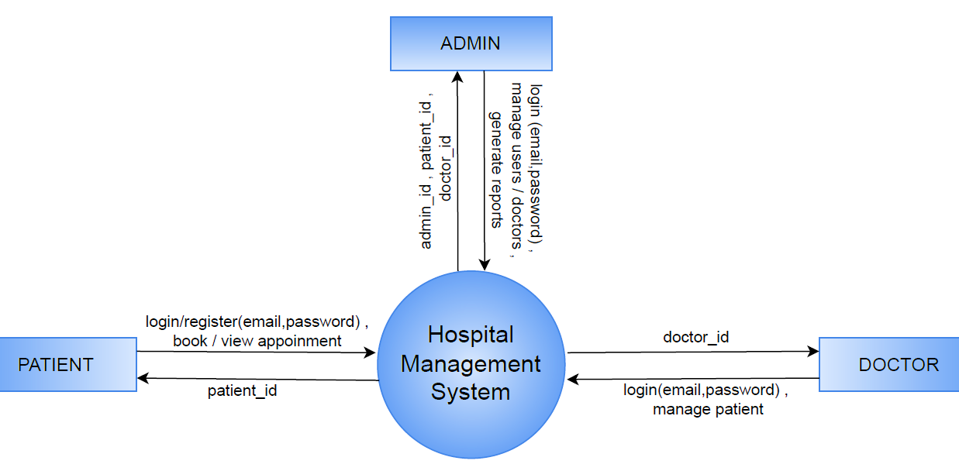
0 (CONTEXT) LEVEL

Slide 12
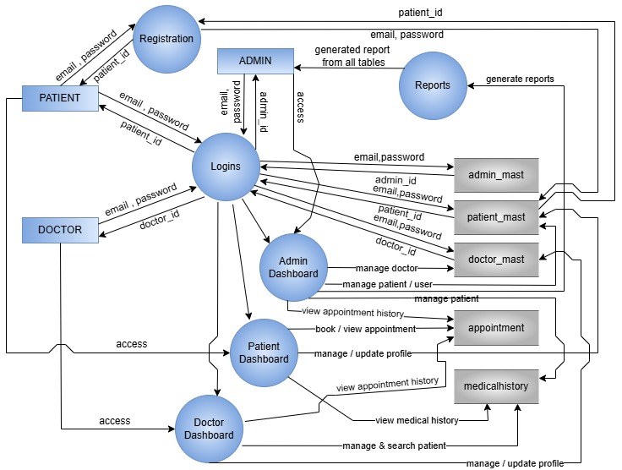
1ST LEVEL

Slide 13
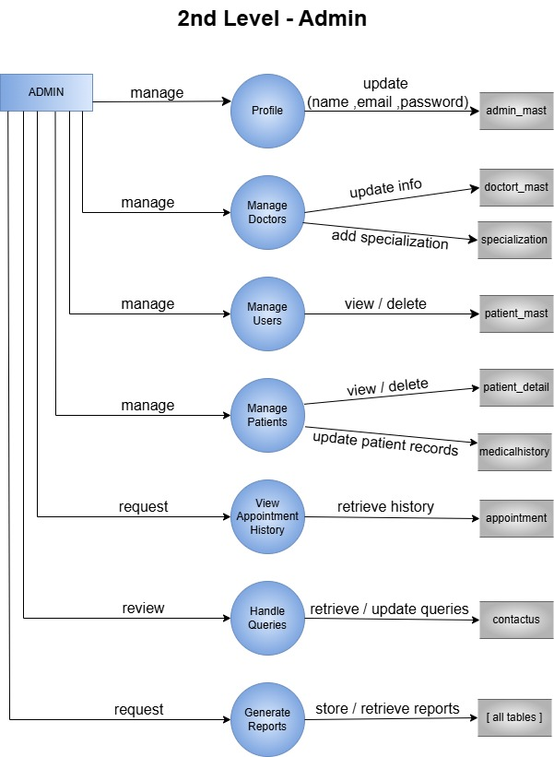
2ND LEVEL(ADMIN)

Slide 14
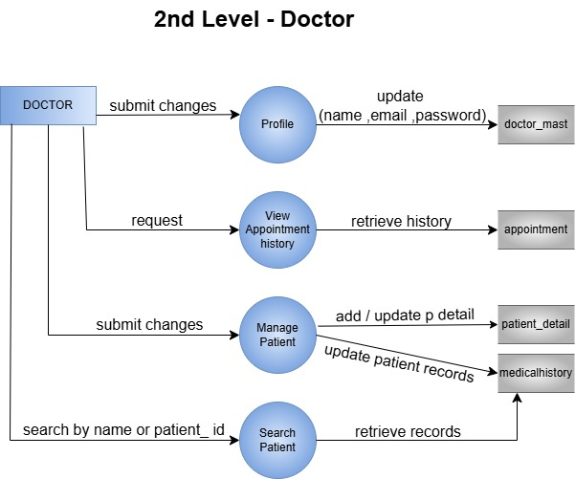
2ND LEVEL(DOCTOR)

Slide 15
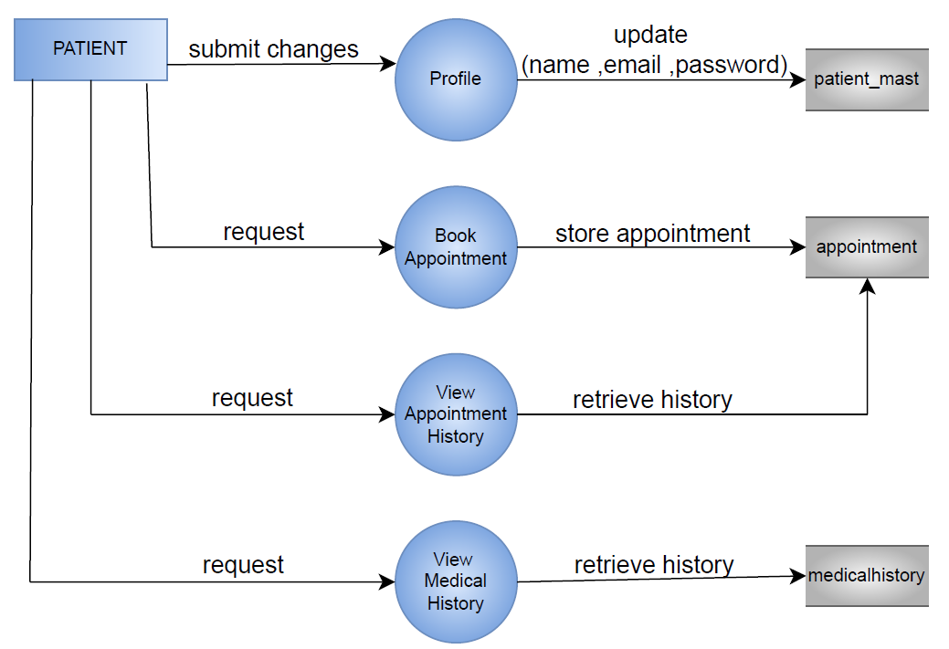
2ND LEVEL(PATIENT)

Slide 16
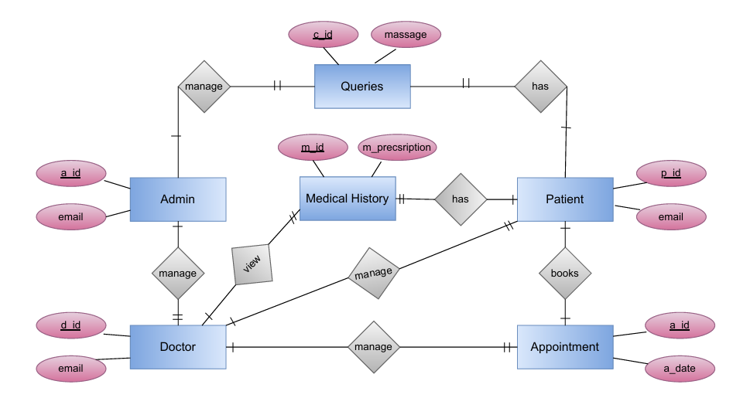
E-R DIAGRAM

Slide 17

DATABASE DESIGN (TABLES)

Slide 18
admin_mast
Field | Type | Null | Key | Default | Extra
a_id | int(11) | NO | PRIMARY KEY | NULL | auto_increment
name | varchar(20) | NO |  | NULL
email | varchar(100) | NO |  | NULL
Password | varchar(255) | NO |  | NULL

Slide 19
doctor_mast
Field | Type | Null | Key | Default | Extra
d_id | int(11) | NO | PRIMARY KEY | NULL | auto_increment
name | varchar(20) | NO |  | NULL
specialization | text | NO |  | NULL
docfees | int(11) | NO |  | NULL
contact | varchar(10) | NO |  | NULL
email | varchar(100) | NO |  | NULL
password | varchar(255) | NO |  | NULL

Slide 20
patient_mast
Field | Type | Null | Key | Default | Extra
p_id | int(11) | NO | PRIMARY KEY | NULL | auto_increment
fullname | varchar(100) | NO |  | NULL
address | varchar(255) | NO |  | NULL
city | varchar(100) | NO |  | NULL
gender | varchar(50) | NO |  | NULL
email | varchar(100) | NO |  | NULL
password | varchar(255) | NO |  | NULL
created_at | timestamp | NO |  | current_timestamp()

Slide 21
patient_detail
Field | Type | Null | Key | Default | Extra
p_detail_id | int(11) | NO | PRIMARY KEY | NULL | auto_increment
d_id | int(11) | NO |  | NULL
p_name | varchar(100) | NO |  | NULL
p_email | varchar(100) | NO |  | NULL
contact_no | varchar(10) | NO |  | NULL
p_gender | varchar(50) | NO |  | NULL
p_add | varchar(100) | NO |  | NULL
p_age | int(11) | NO |  | NULL
p_medhis | varchar(100) | NO |  | NULL
created_at | timestamp | NO |  | current_timestamp()

Slide 22
appointment
Field | Type | Null | Key | Default | Extra
a_id | int(11) | NO | PRIMARY KEY | NULL | auto_increment
specilization | varchar(100) | NO |  | NULL
d_id | int(11) | NO |  | NULL
p_id | int(11) | NO |  | NULL
fees | int(11) | NO |  | NULL
a_date | varchar(255) | NO |  | NULL
a_time | varchar(255) | NO |  | NULL
postingdate | timestamp | NO |  | current_timestamp()
userstatus | int(11) | NO |  | NULL
d_status | int(11) | NO |  | NULL

Slide 23
specilization
Field | Type | Null | Key | Default | Extra
s_id | int(11) | NO | PRIMARY KEY | NULL | auto_increment
specilization | varchar(50) | NO |  | NULL
created_at | timestamp | NO |  | current_timestamp()

Slide 24
medical_history
Field | Type | Null | Key | Default | Extra
m_id | int(10) | NO | PRIMARY KEY | NULL | auto_increment
p_detail_id | int(10) | YES |  | NULL
bp | varchar(200) | YES |  | NULL
bs | varchar(200) | NO |  | NULL
weight | varchar(100) | YES |  | NULL
temperature | varchar(200) | YES |  | NULL
m_prescription | mediumtext | YES |  | NULL
created_at | timestamp | NO |  | current_timestamp() | on update current_timestamp()

Slide 25
pages
Field | Type | Null | Key | Default | Extra
id | int(11) | NO | PRIMARY KEY | NULL | auto_increment
img | varchar(100) | NO |  | NULL
type | varchar(100) | NO |  | NULL
category | varchar(20) | NO |  | NULL
description | text | NO |  | NULL

Slide 26
contactus
Field | Type | Null | Key | Default | Extra
c_id | int(11) | NO | PRIMARY KEY | NULL | auto_increment
name | varchar(100) | NO |  | NULL
email | varchar(100) | NO |  | NULL
mobile | text | NO |  | NULL
message | varchar(255) | NO |  | NULL
created_at | timestamp | NO |  | current_timestamp()

Slide 27

MAIN INDEX

Slide 28


Slide 30
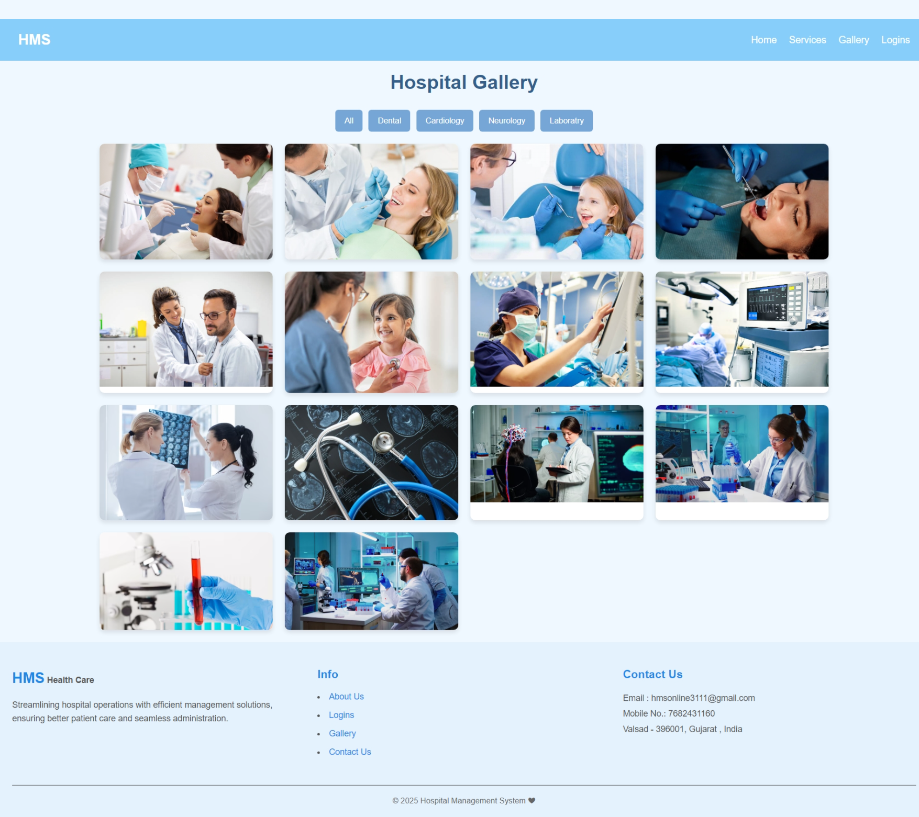
Gallery:

Slide 31
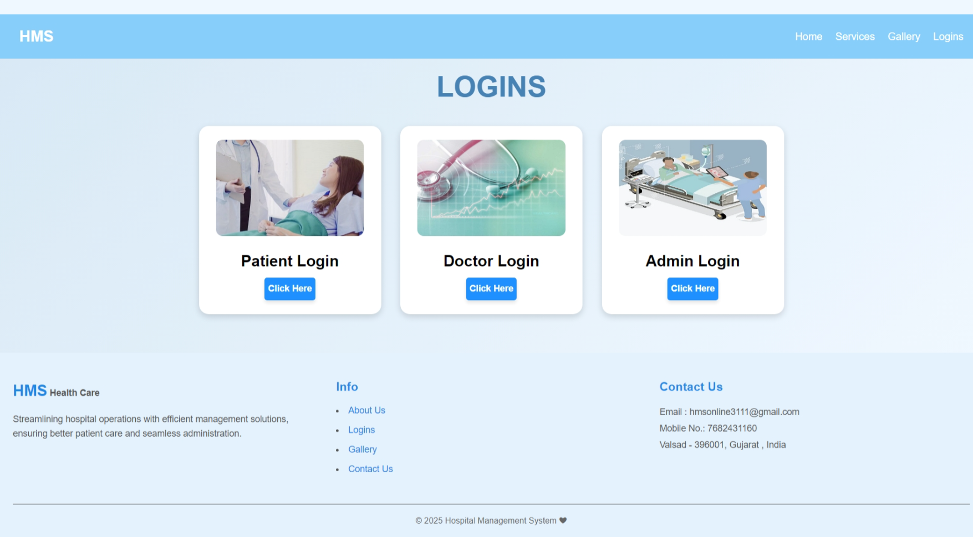
Logins:

Slide 32
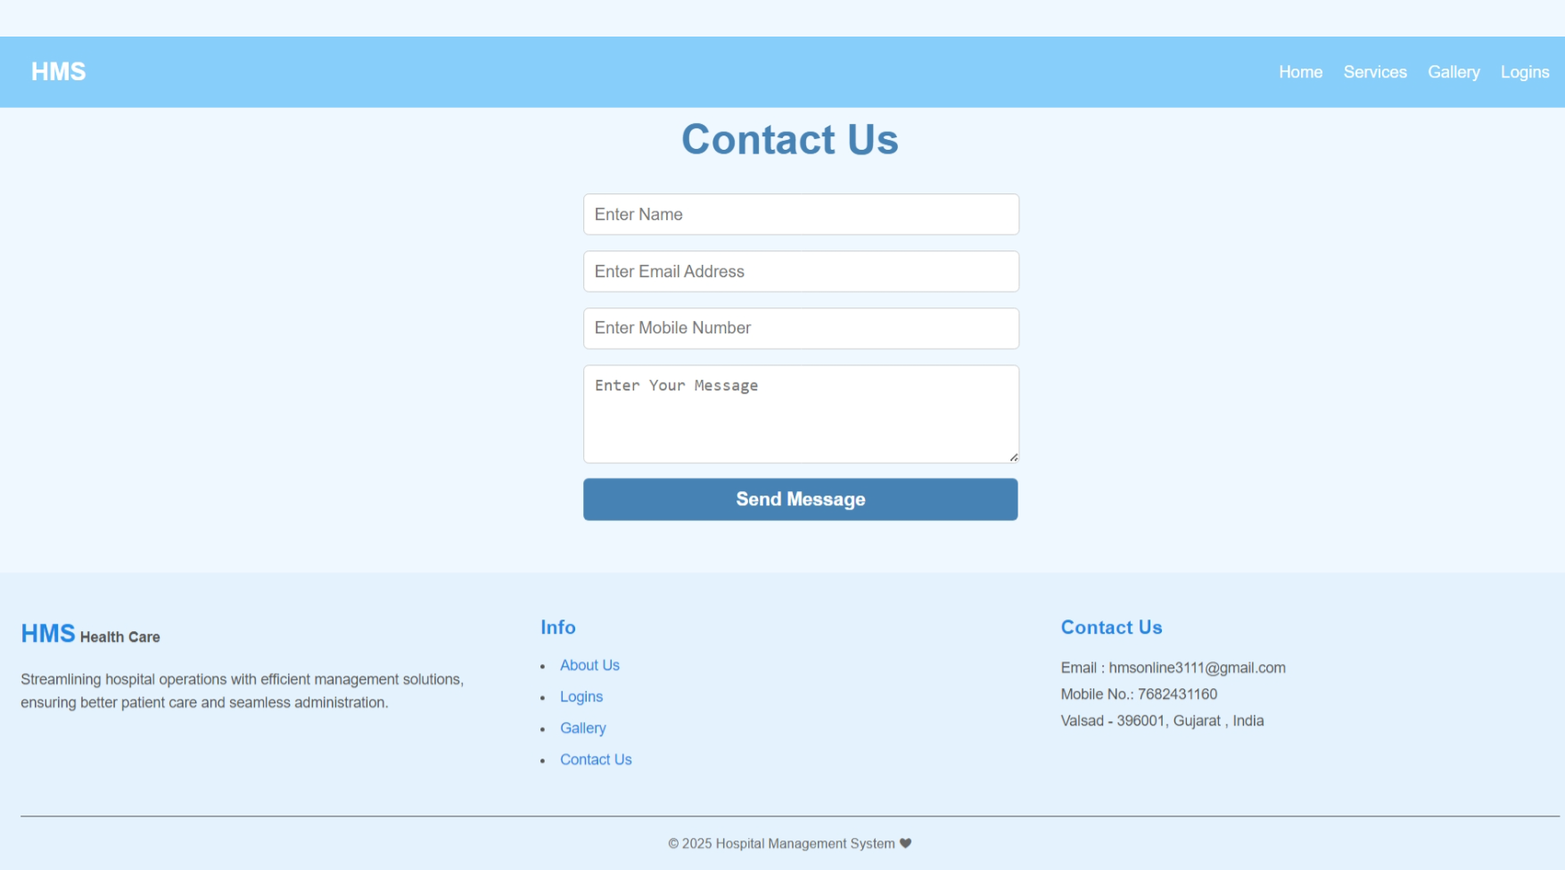
Contact Us:

Slide 33

ADMIN SIDE

Slide 34
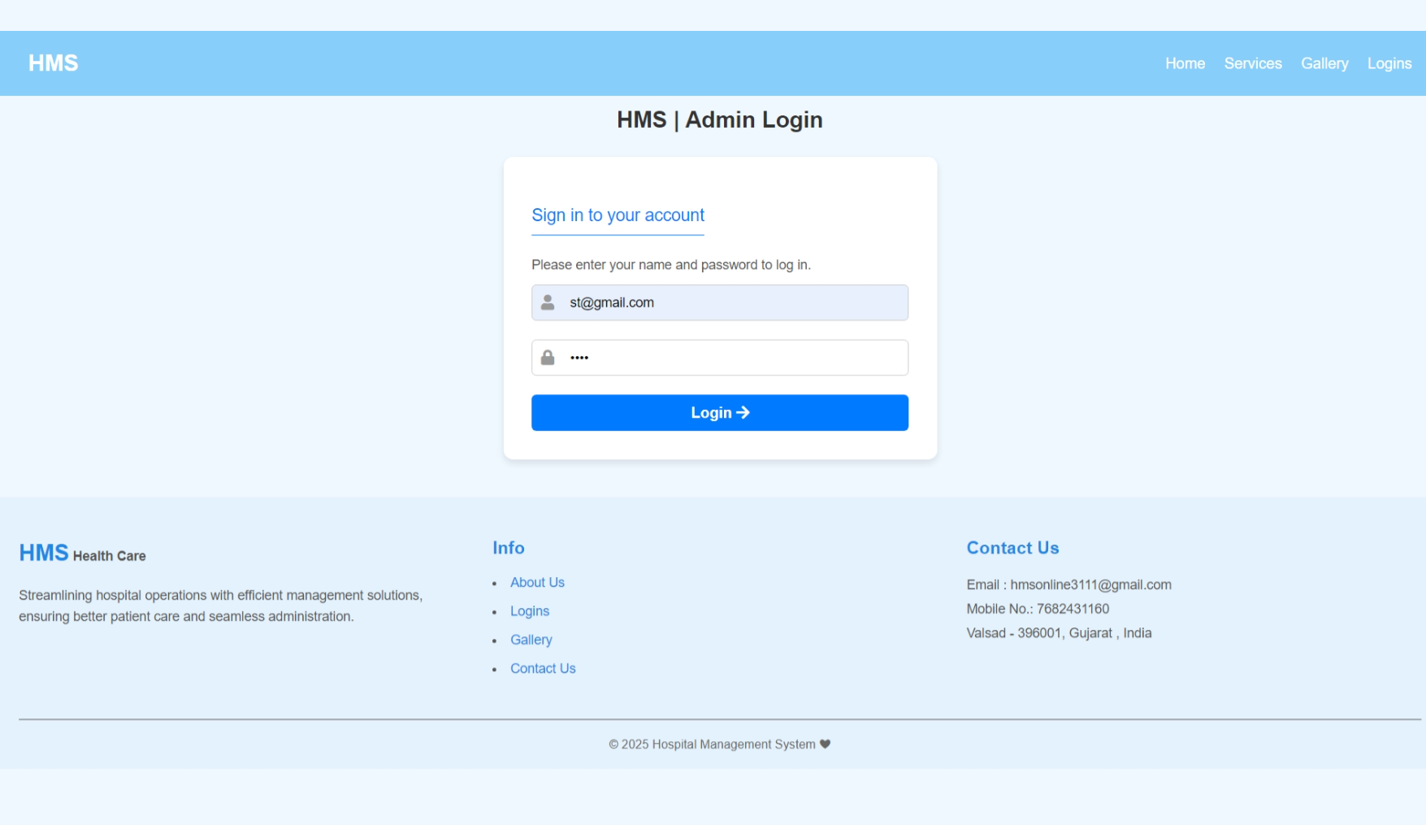
Admin Login:

Slide 35
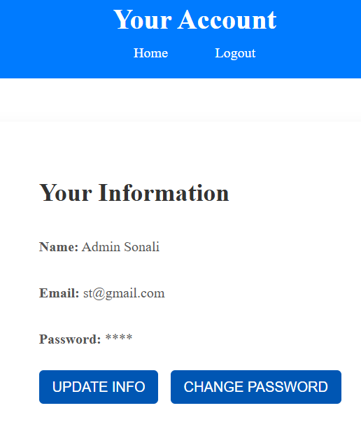
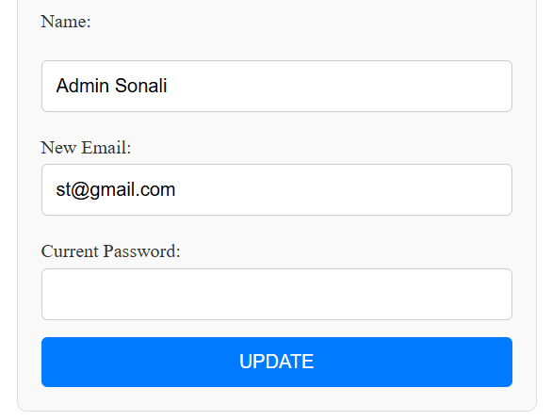
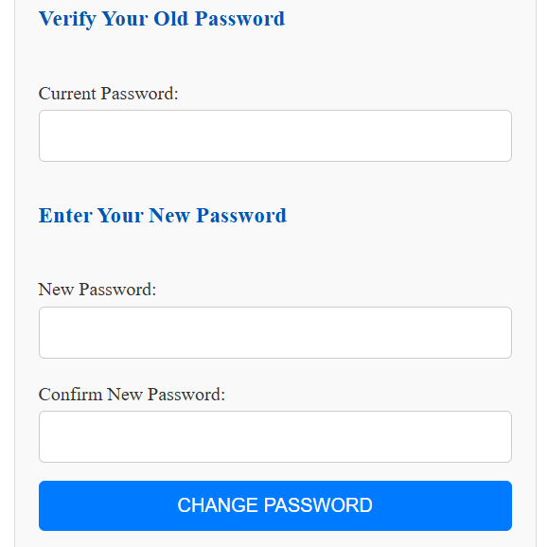
Admin Account:

Slide 36
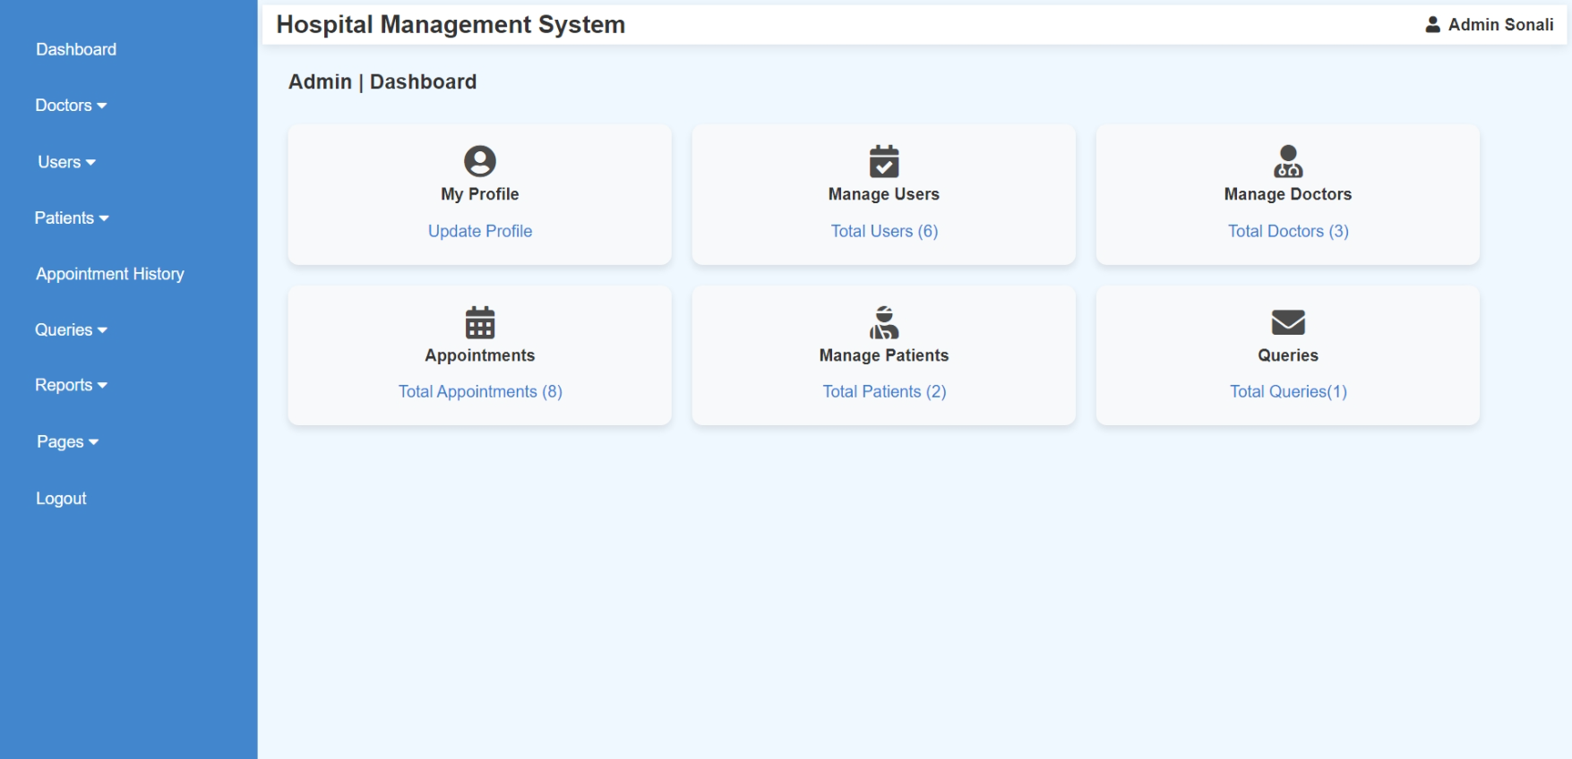
Admin Dashboard:

Slide 37
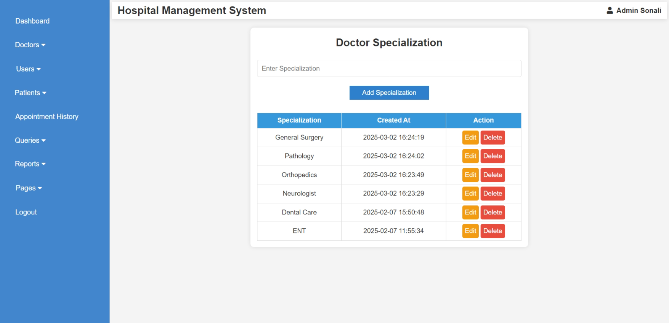
Admin (Manage Doctor): 1. Add Specialization

Slide 38
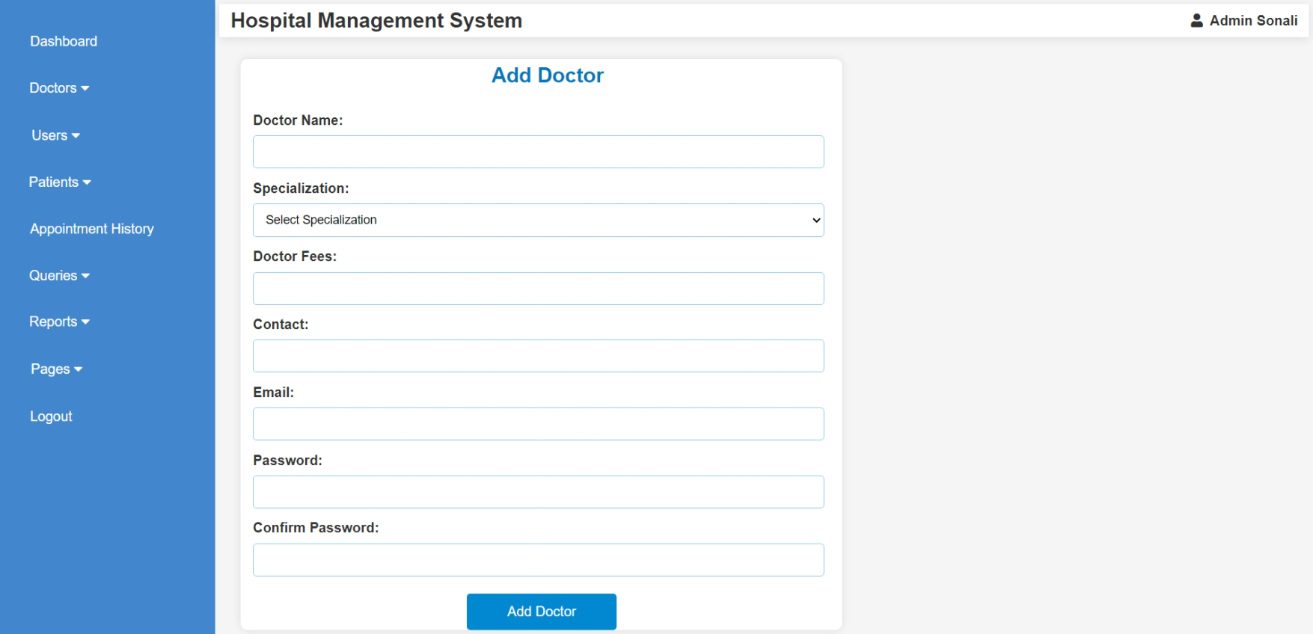
Admin (Manage Doctor): 2. Add Doctor

Slide 39
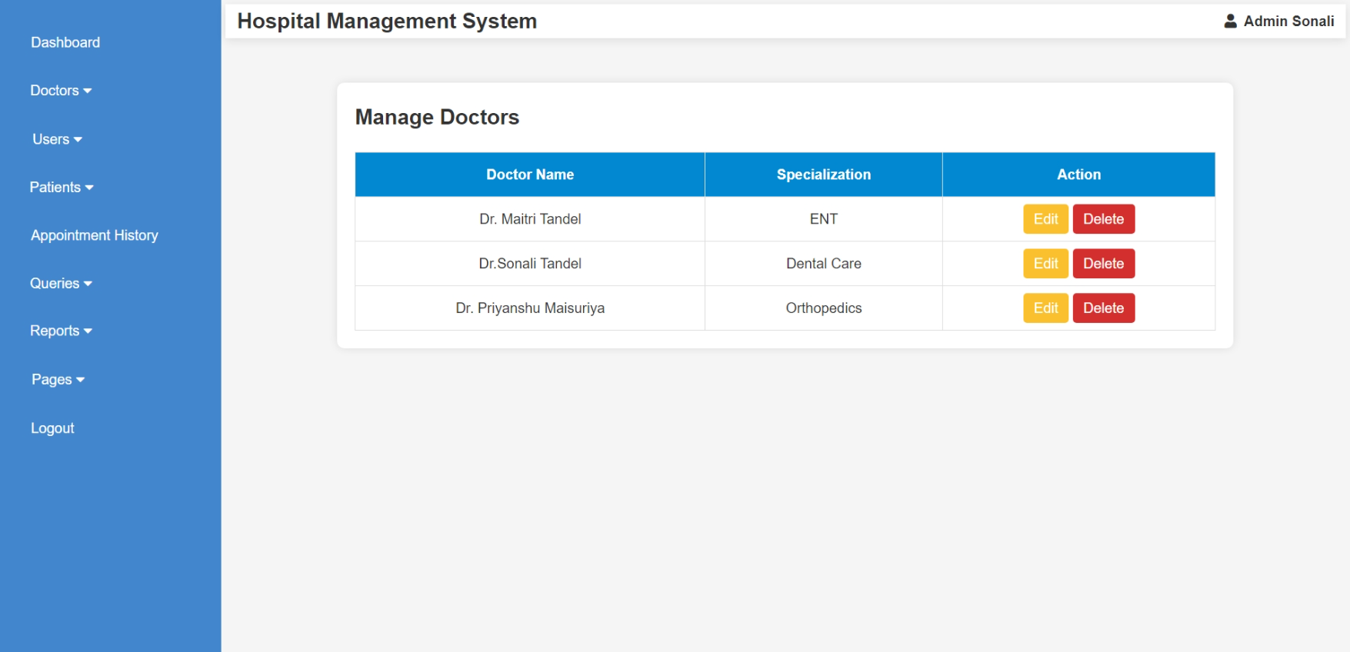
Admin (Manage Doctor): 3. View & Edit Doctors

Slide 40
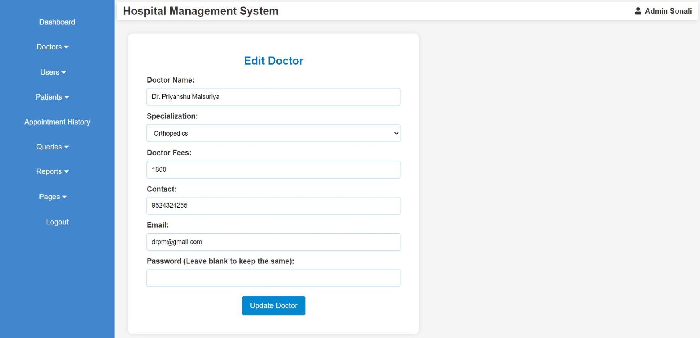

Slide 41
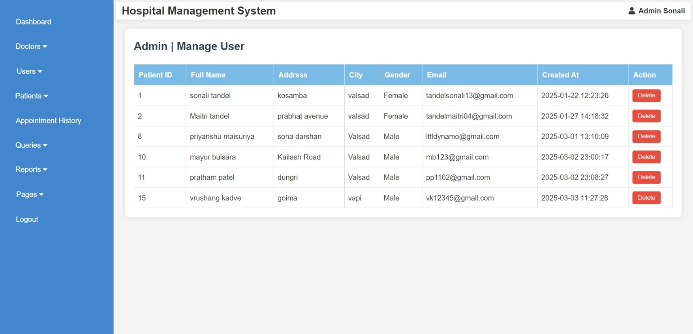
Admin (Manage User):

Slide 42
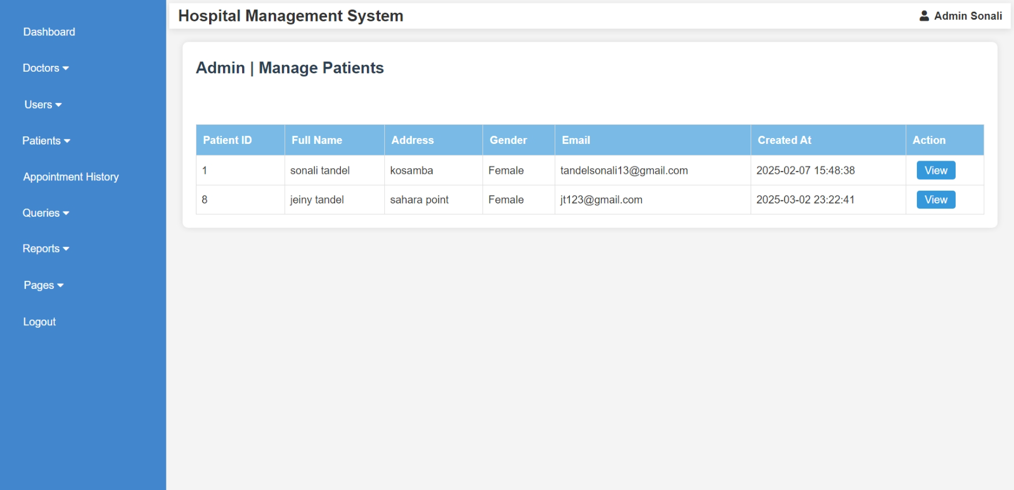
Admin (Manage Patient & View Details):

Slide 43
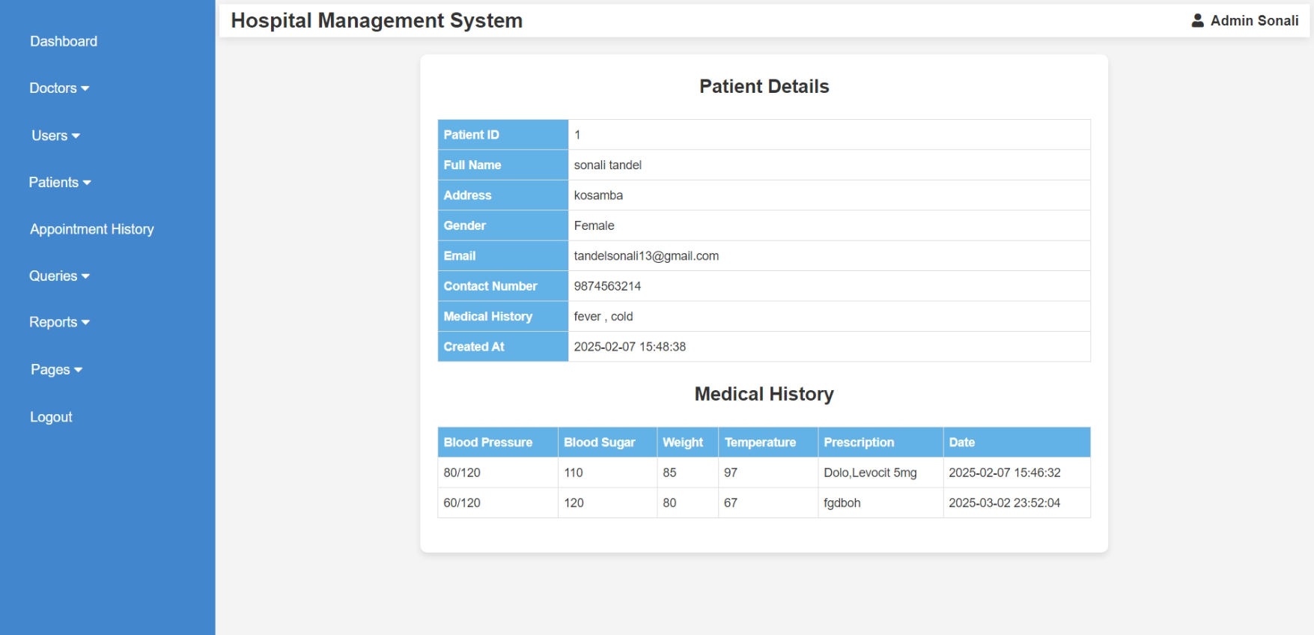

Slide 44
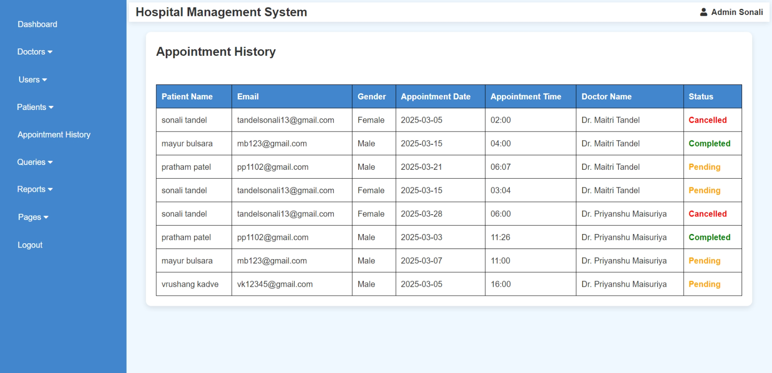
Admin (View Appointment Histories):

Slide 45
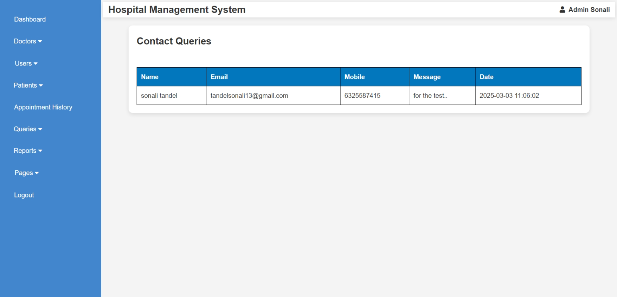
Admin (Read Queries):

Slide 46
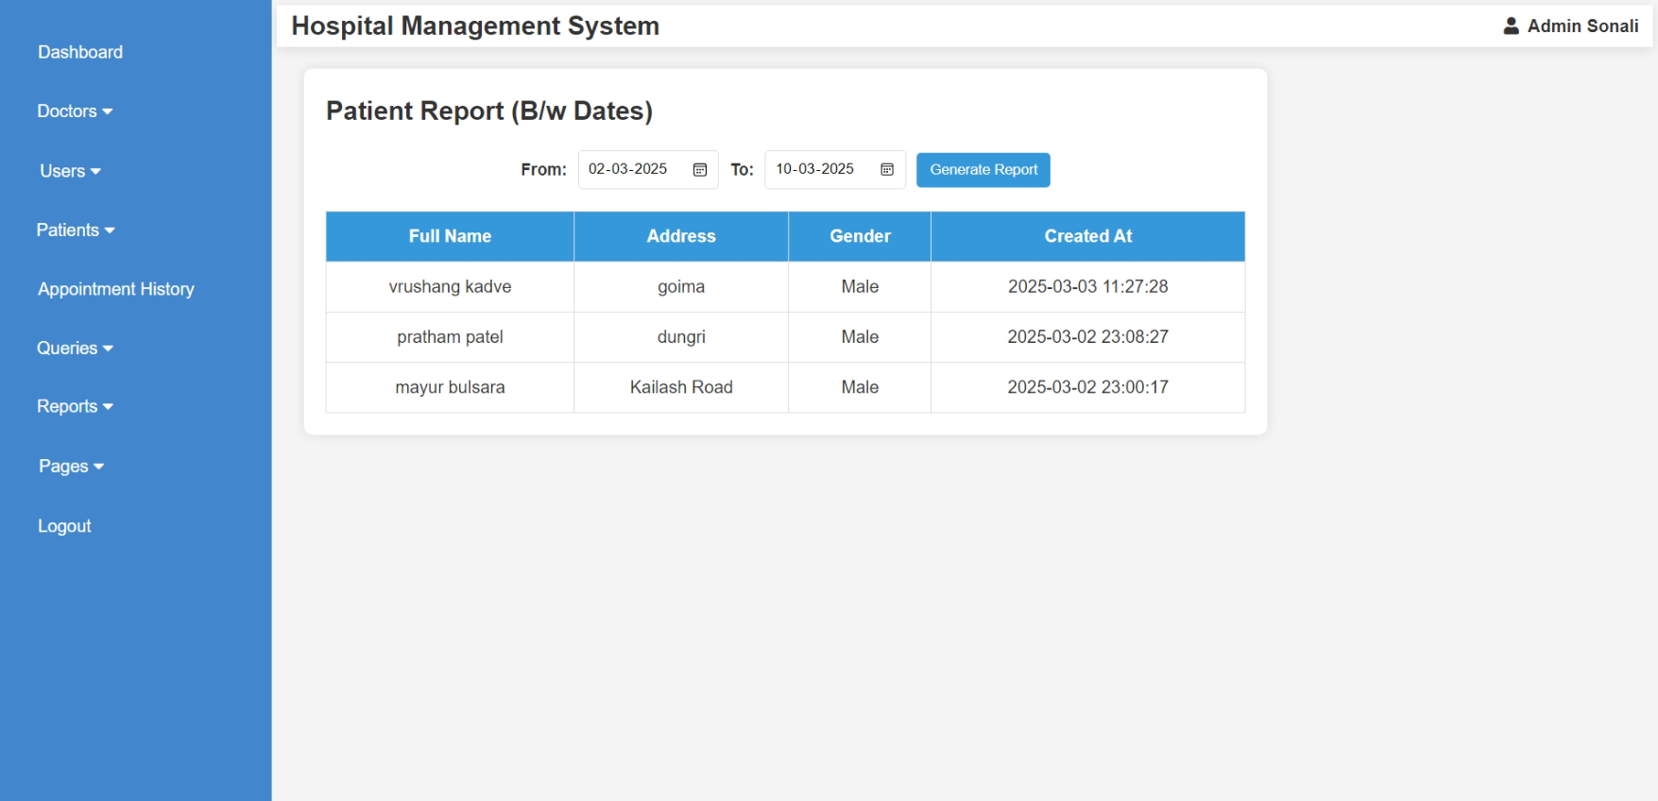
Admin (View Reports ):

Slide 47
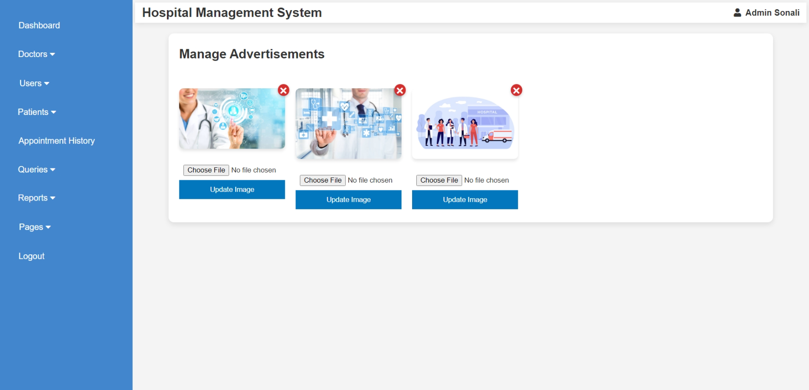
Admin (Manage Pages): 1. Advertisement

Slide 48
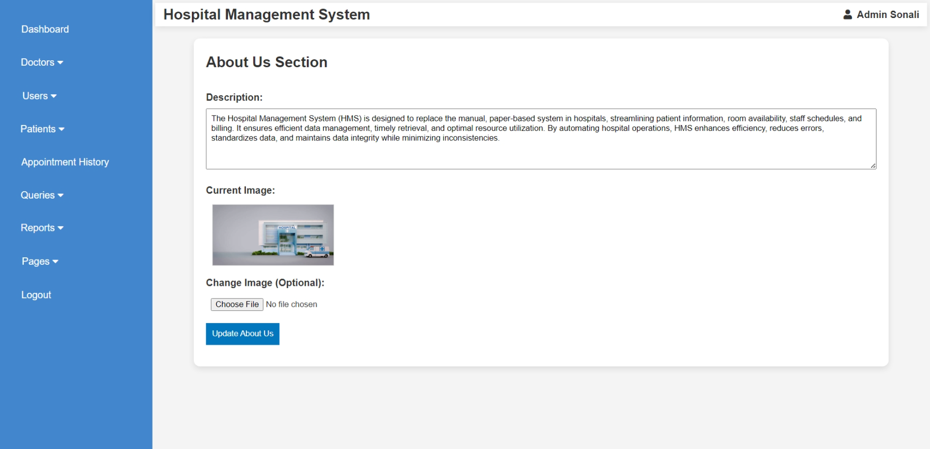
Admin (Manage Pages): 2. About Us

Slide 49
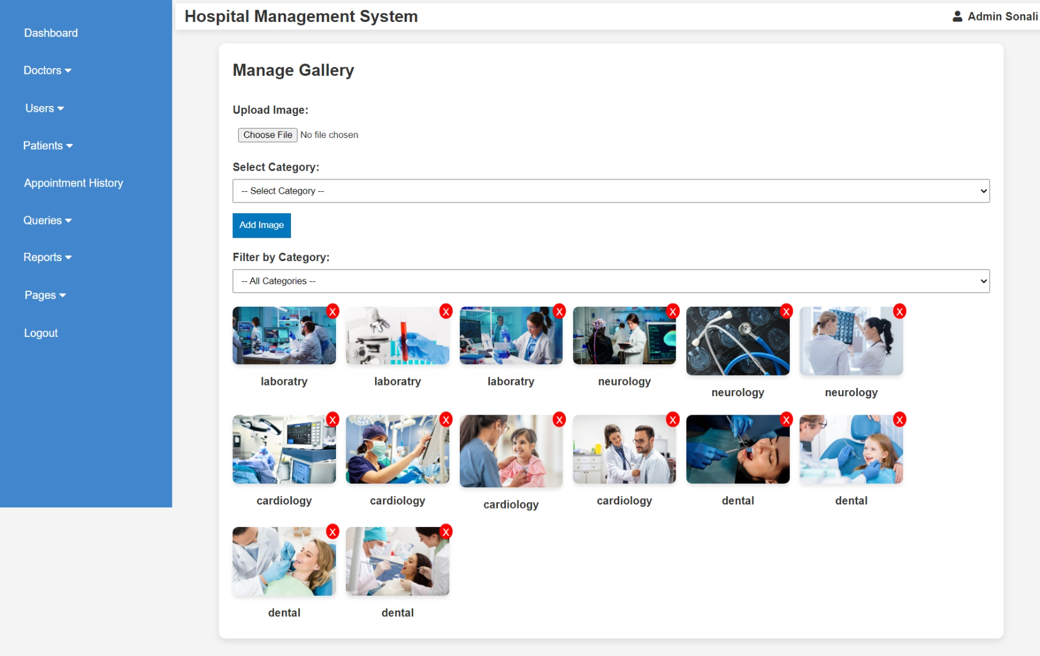
Admin (Manage Pages): 3. Gellary

Slide 50

DOCTOR SIDE

Slide 51
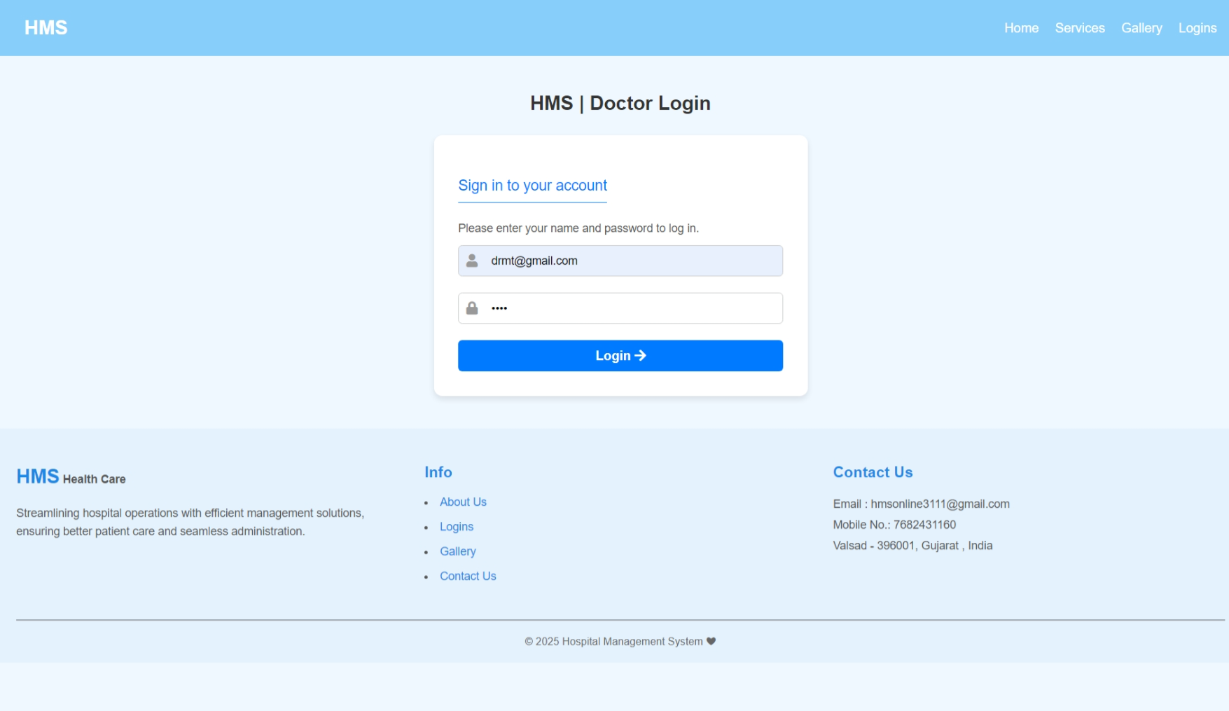
Doctor Login:

Slide 52
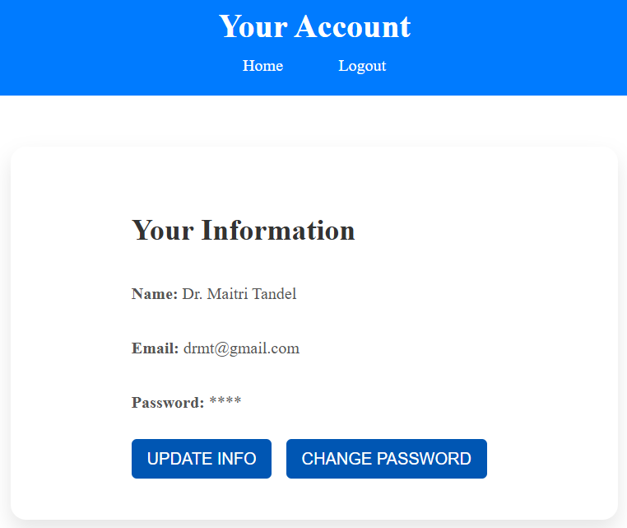
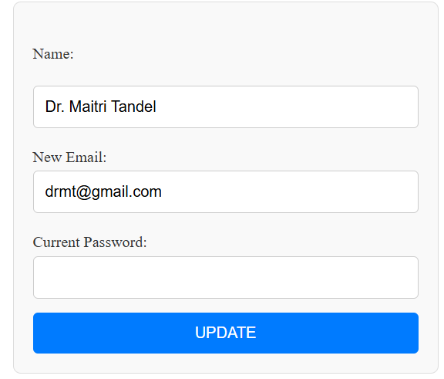
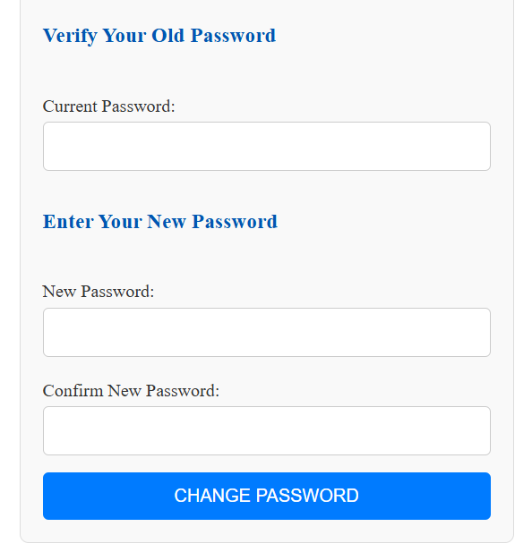
Doctor Account:

Slide 53
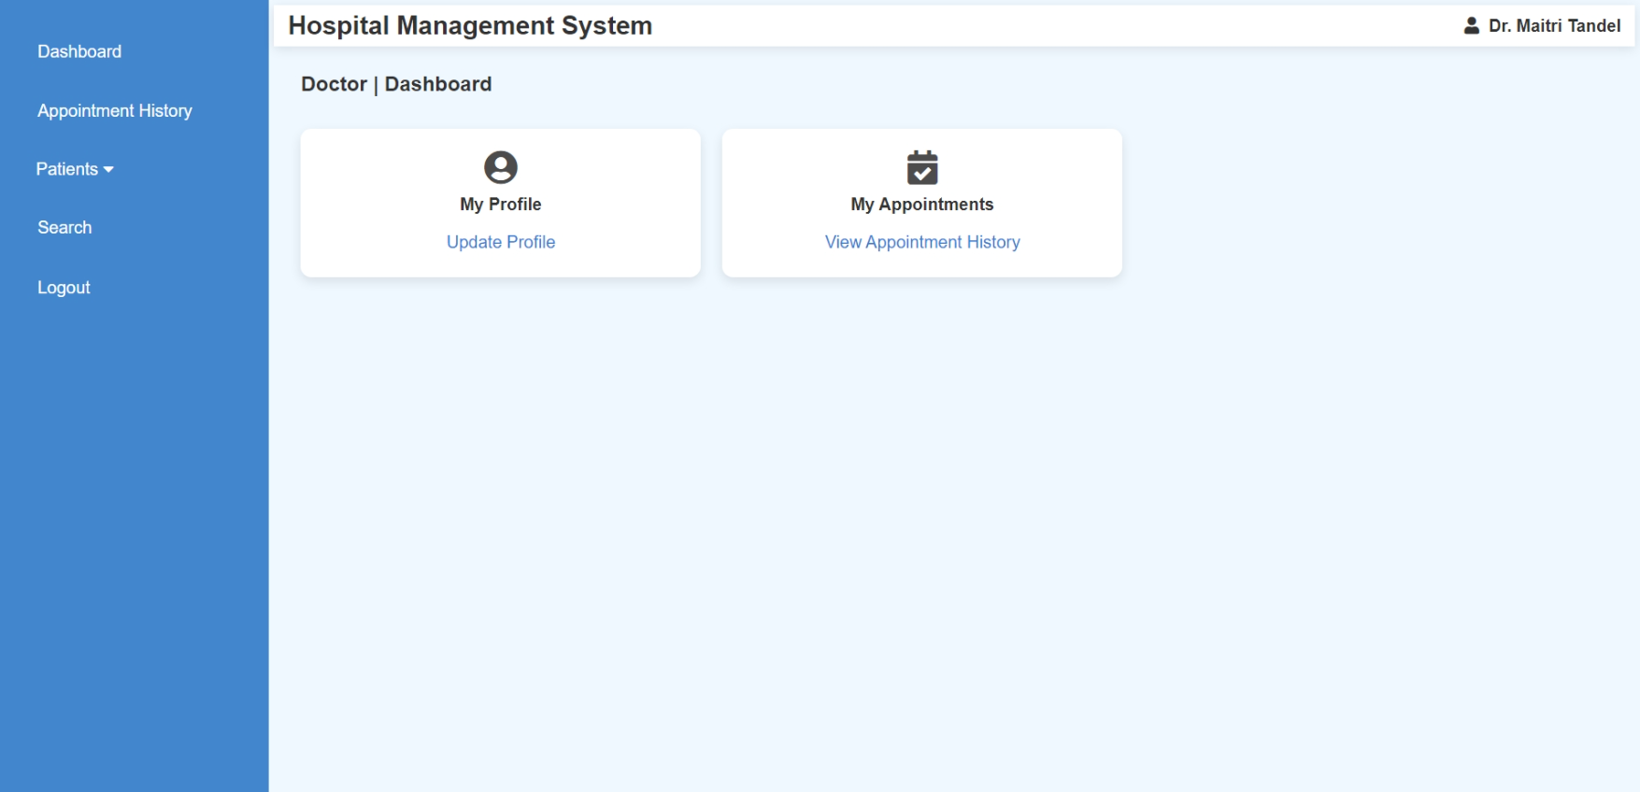
Doctor Dashboard:

Slide 54
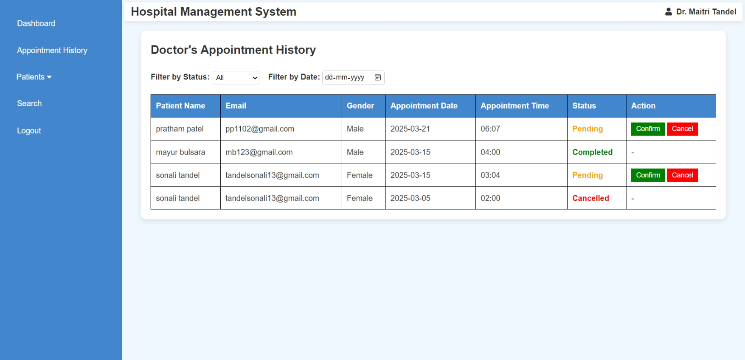
Doctor (Manage Appointment History):

Slide 55
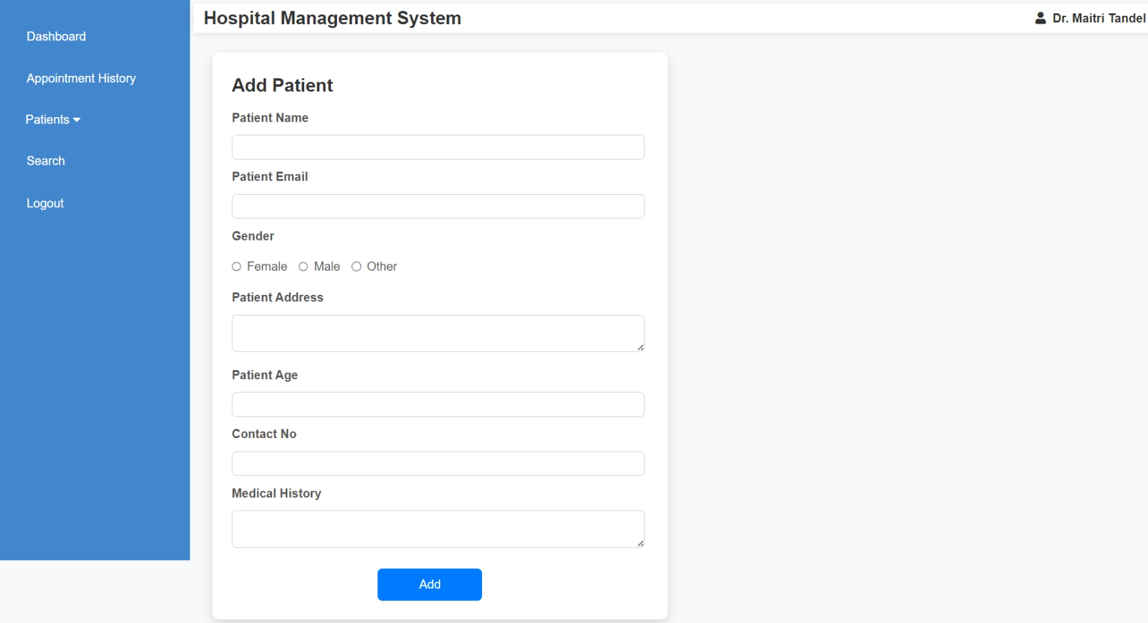
Doctor (Manage Patient): 1. Add Patient

Slide 56
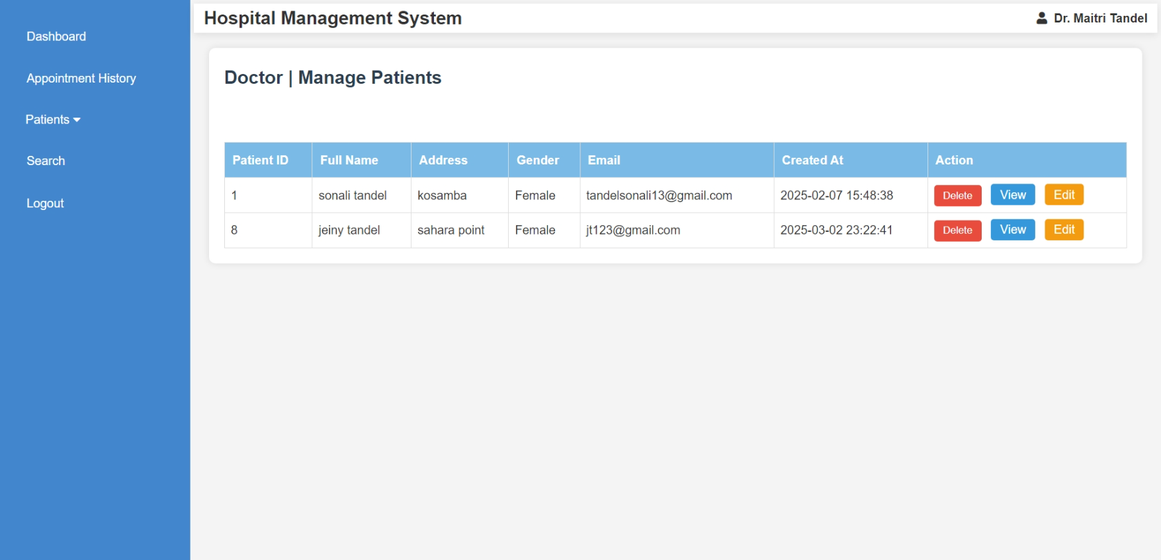
Doctor (Manage Patient): 2. View & Edit Patient Details

Slide 57
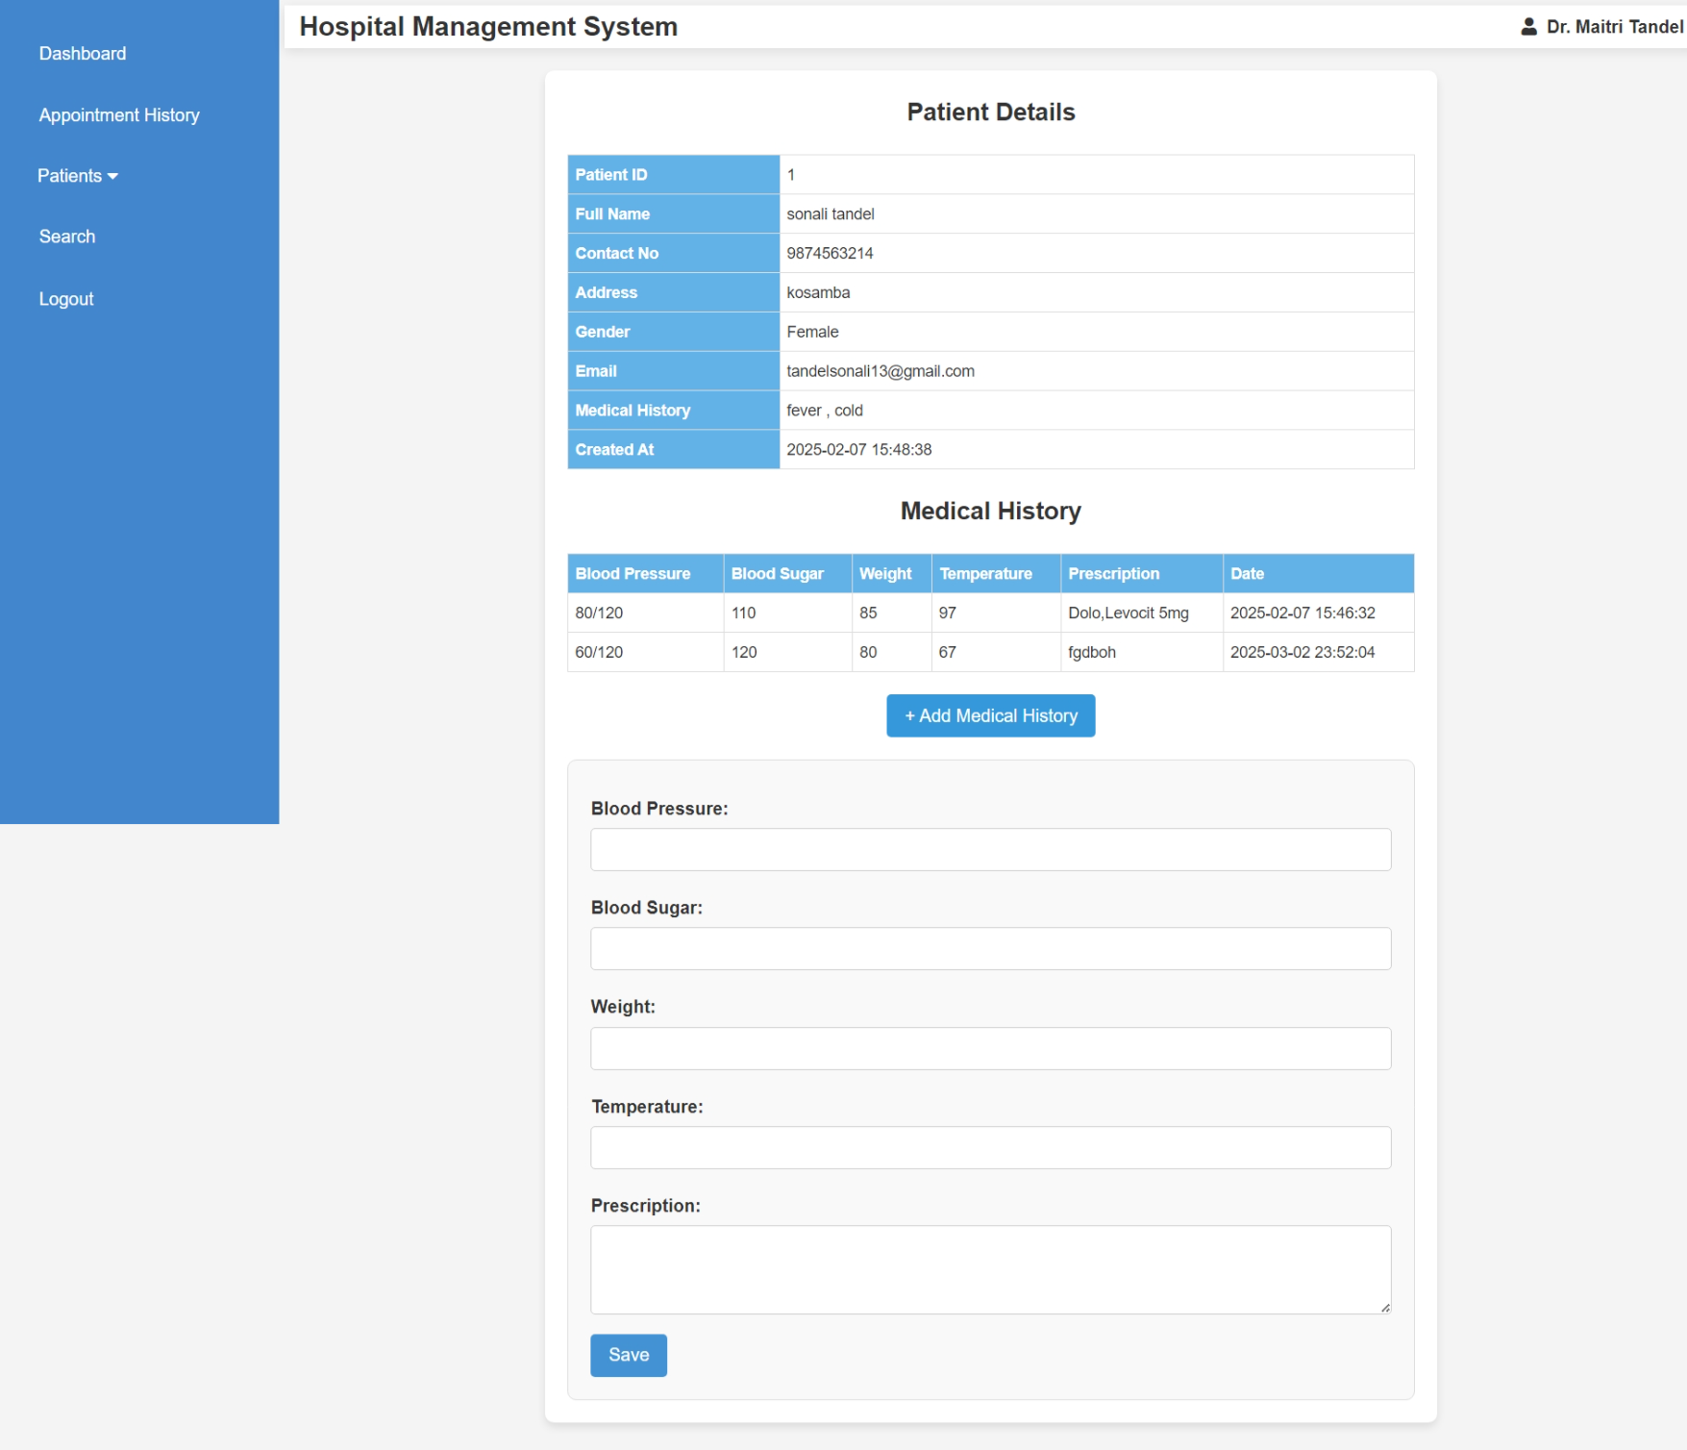

Slide 58
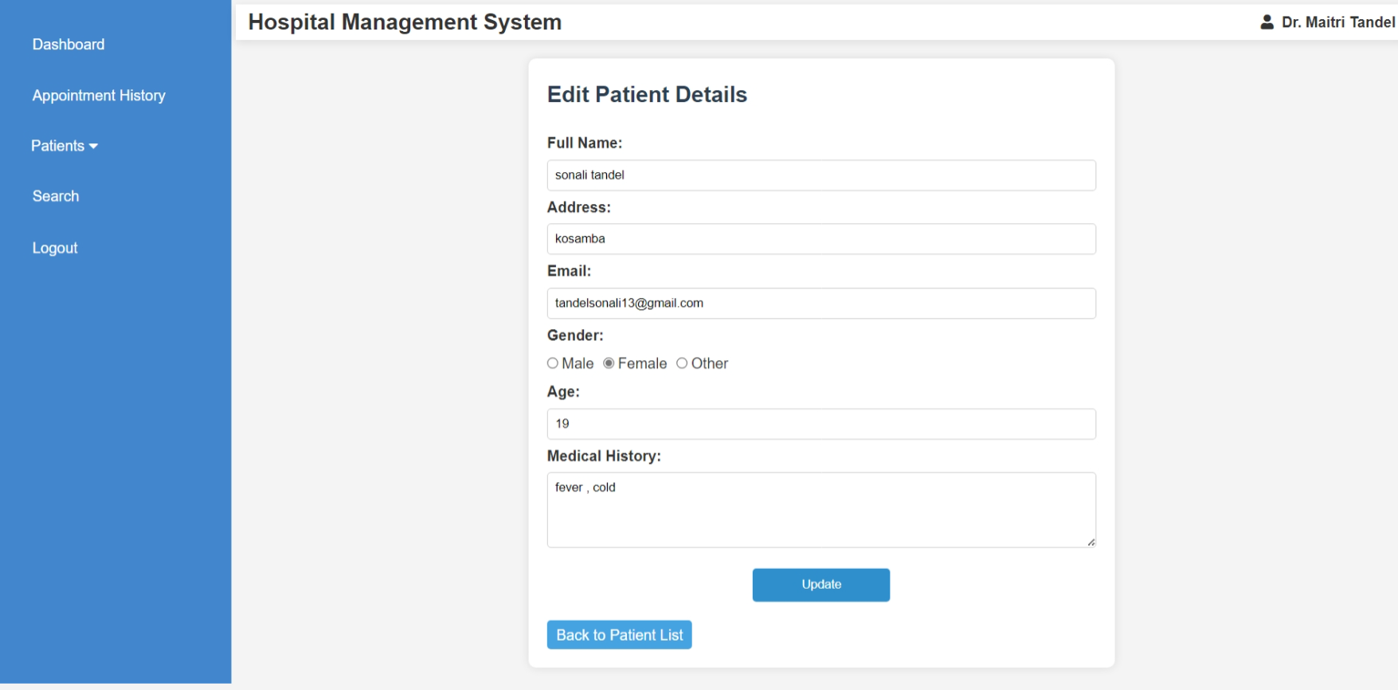

Slide 59
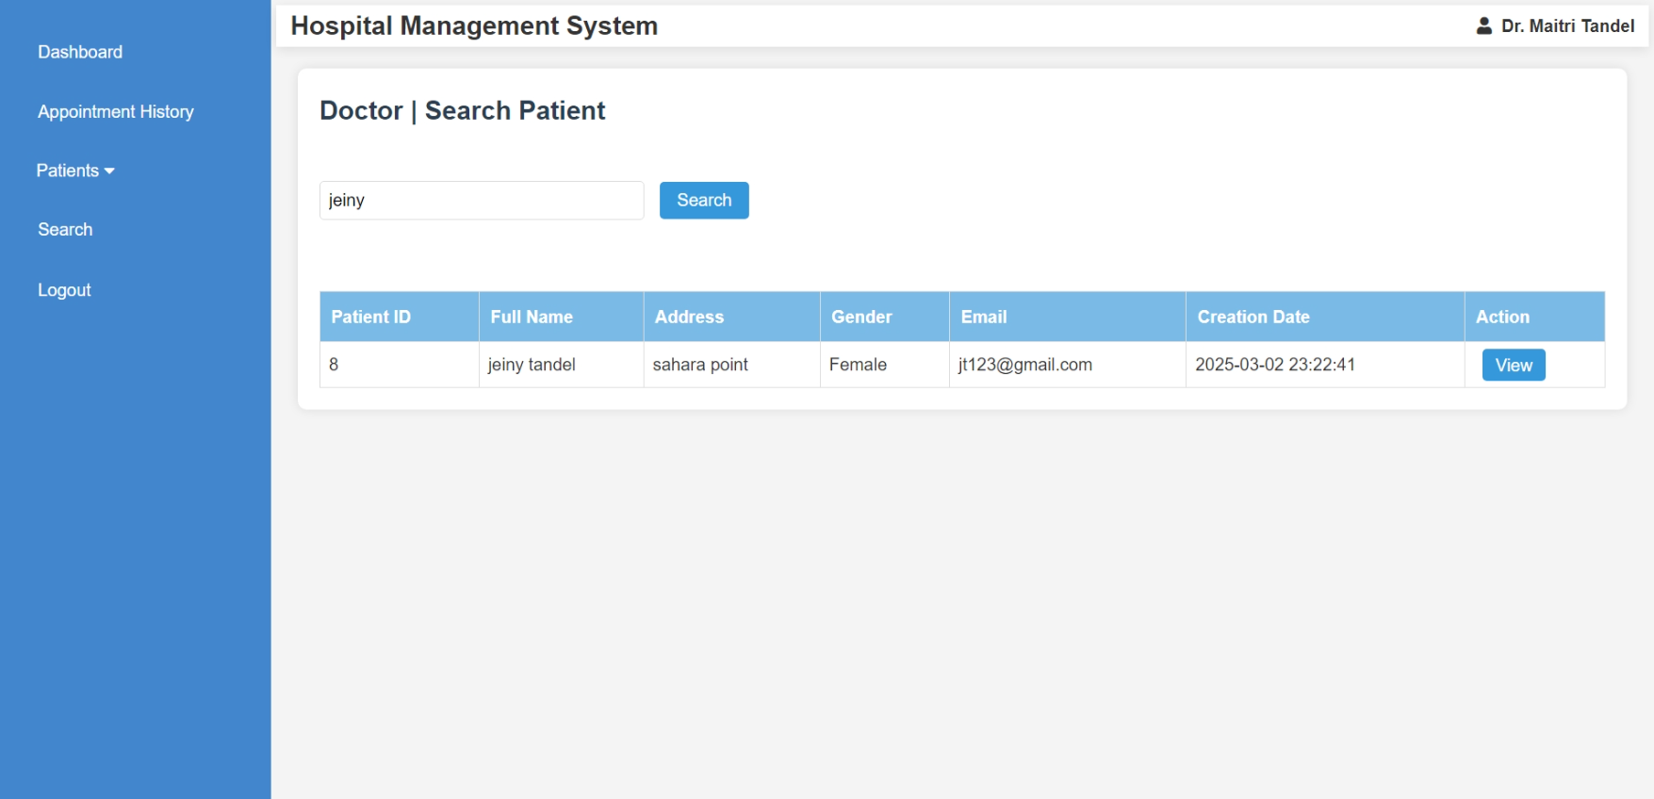
Doctor (Search Patient):

Slide 60

PATIENT SIDE

Slide 61
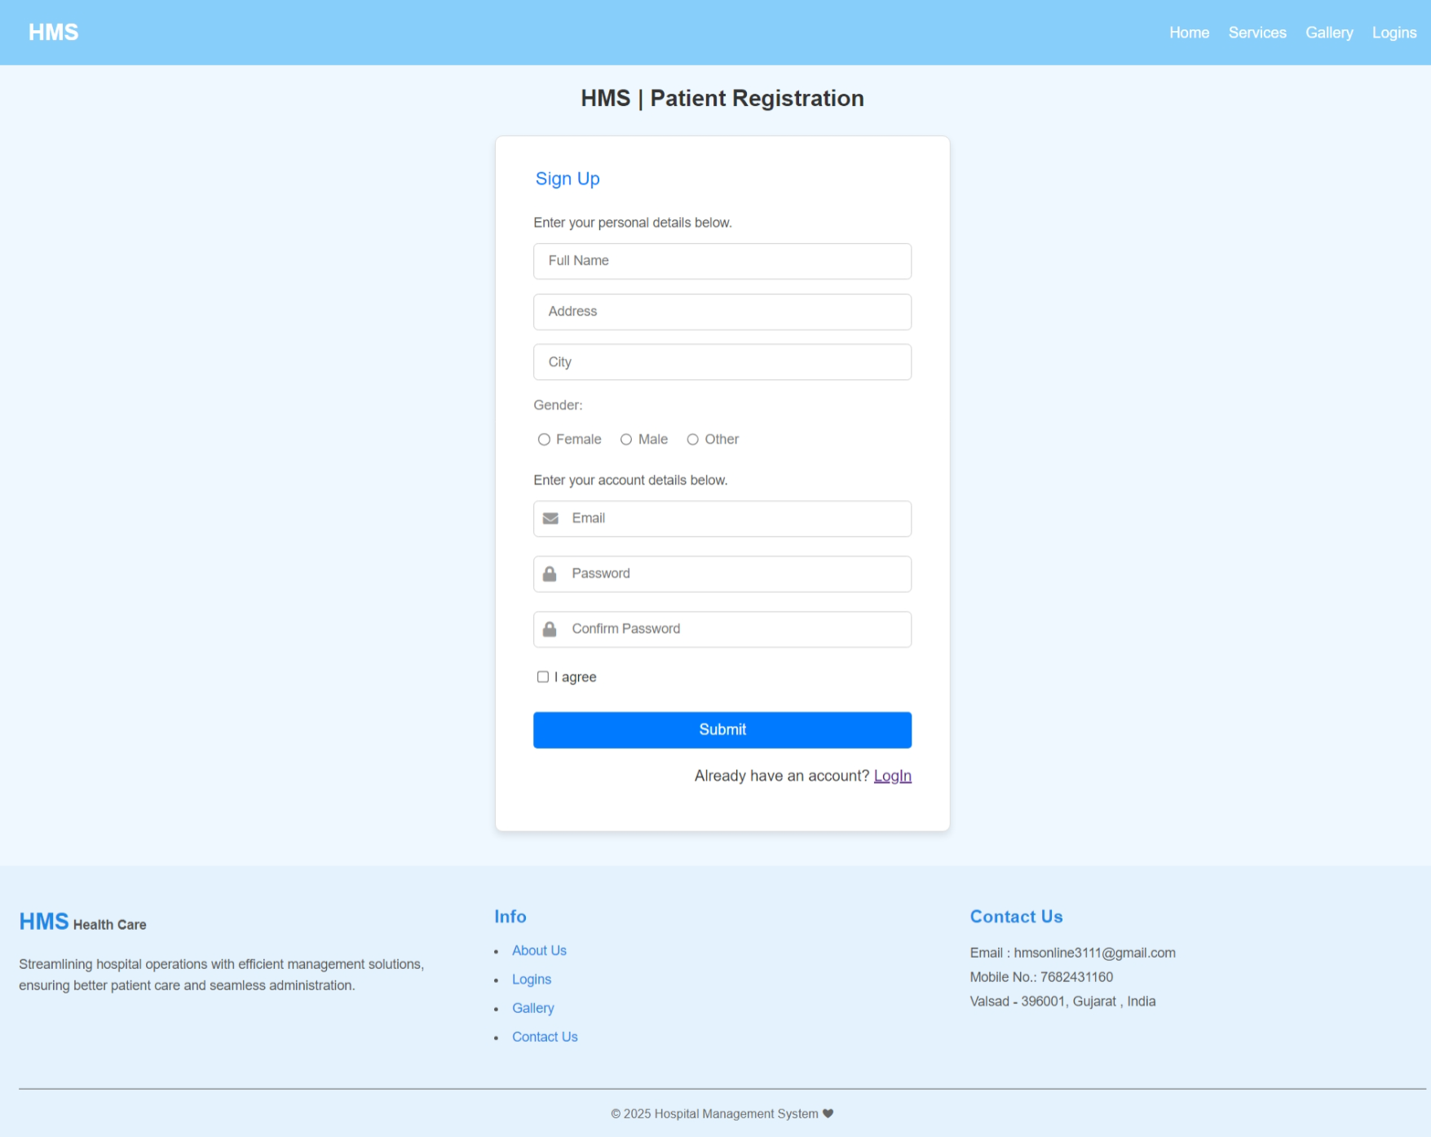
Patient Registration:

Slide 62
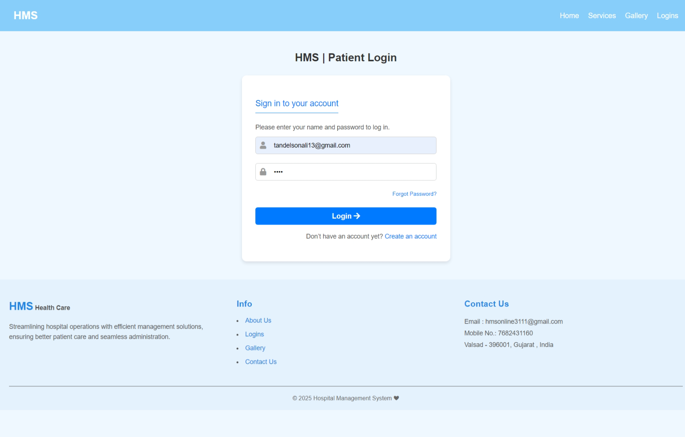
Patient Login:

Slide 63
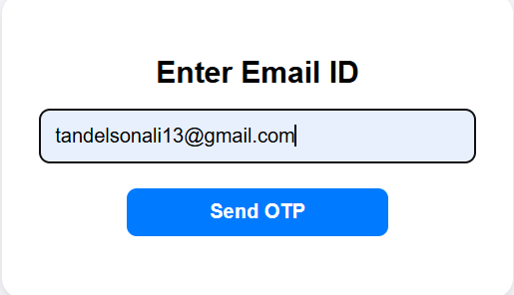
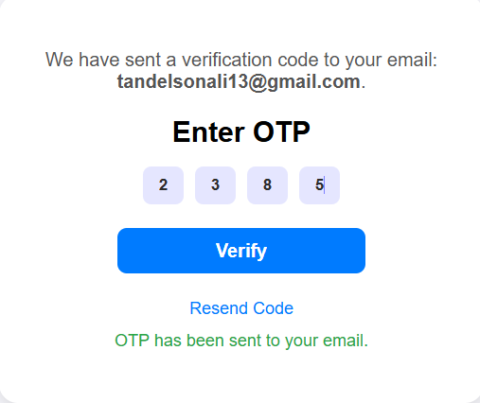
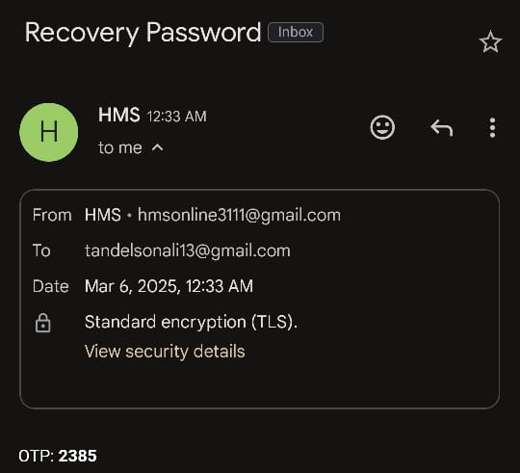
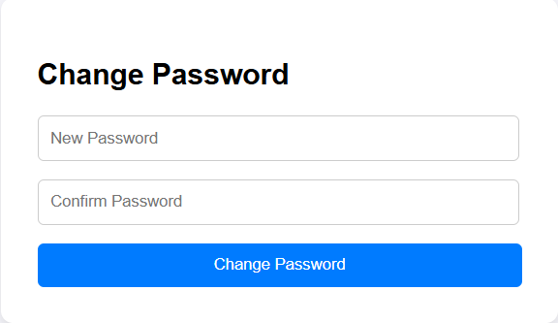
Patient (Forget Password):

Slide 64
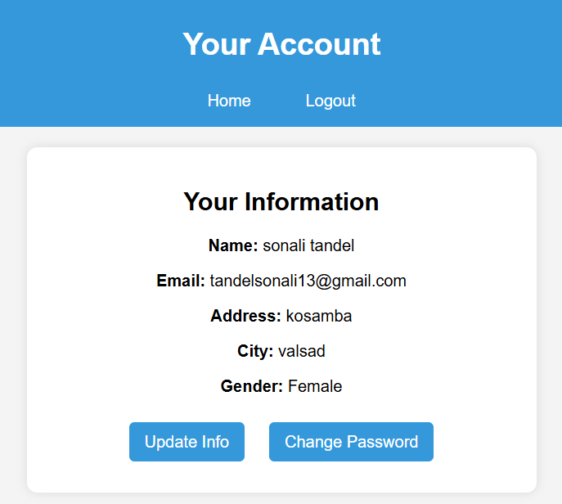
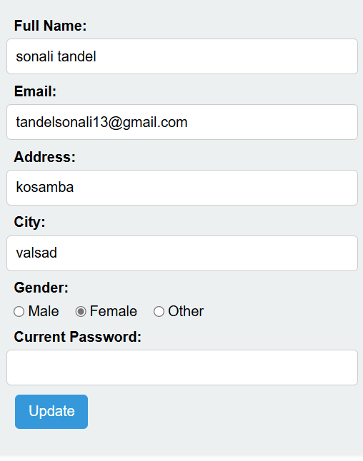
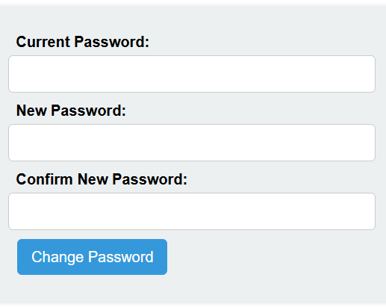
Patient Account:

Slide 65
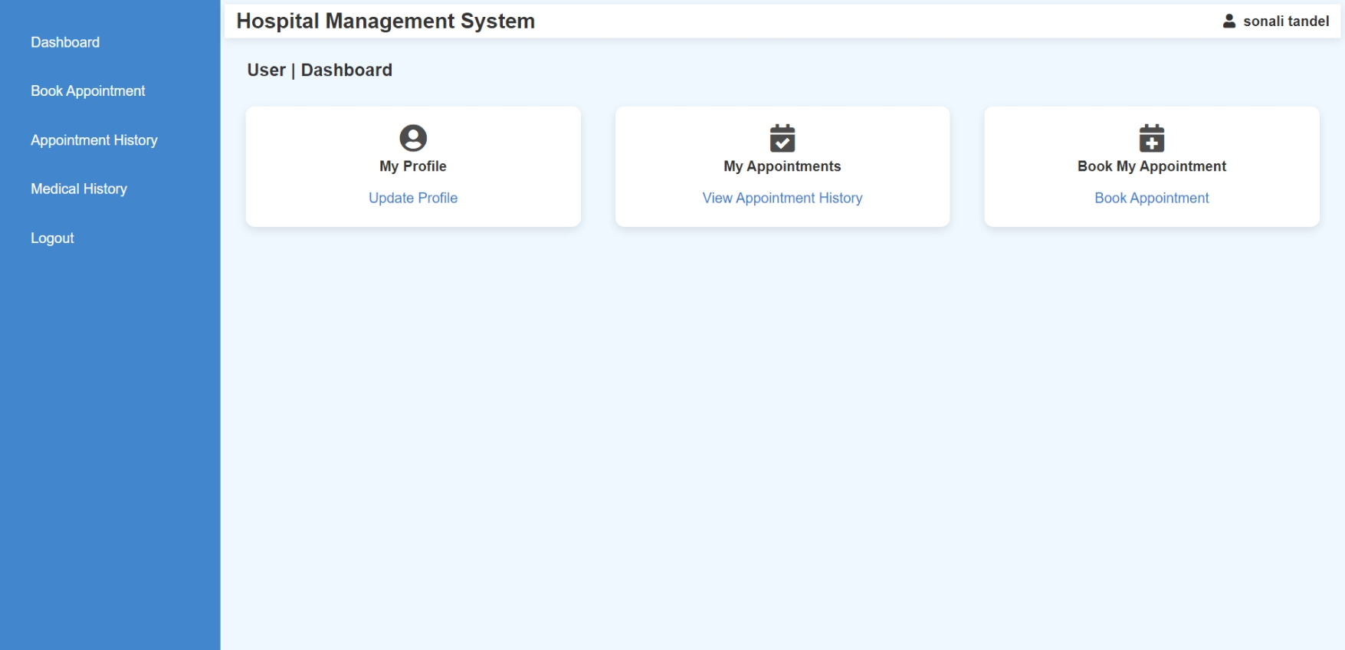
Patient Dashboard:

Slide 66
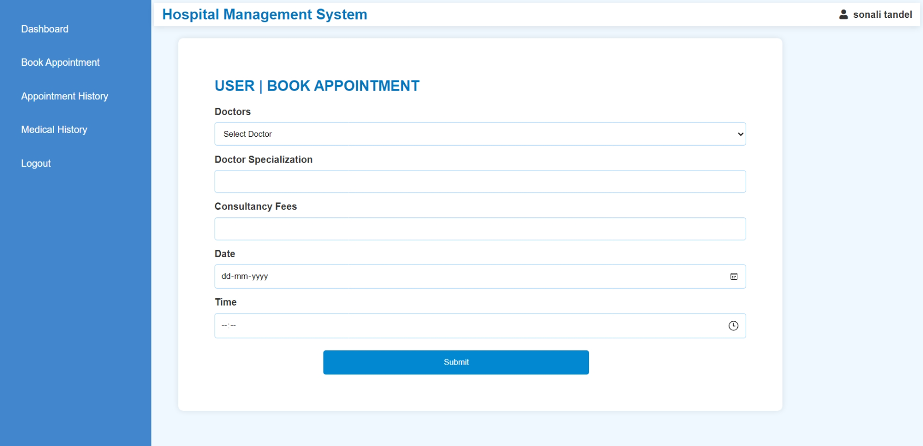
Patient Book Appointment:

Slide 67
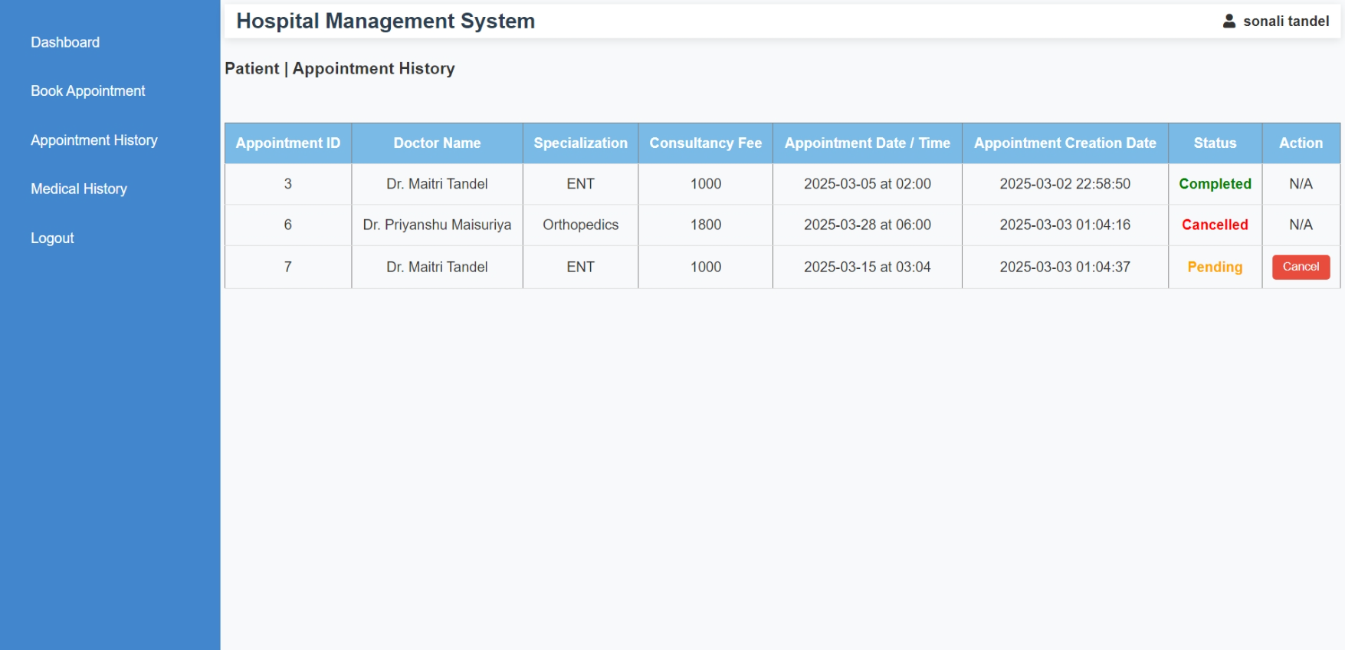
Patient Book Appointment:

Slide 68

Patient Medical History:

Slide 69

Logout:

Slide 70
SUMMARY
HMS is a web-based application that allows hospitals to manage operations digitally.
Features include:
User authentication for security.
Role-based access control (Admin, Doctor, Patient).
Intuitive user interface for better experience.

Slide 71
REFERENCE
Hospital Management System In PHP ,Download Hospital Management System Project on PHP
Hospital vectors, photos and PSD files | Free download

Slide 72

THANK YOU

